Slide 1
Coordination compounds and Organometallics
Dr Suban K Sahoo
Asst Prof., Applied Chemistry Department
Lecture duration: 6 hrs

Slide 2
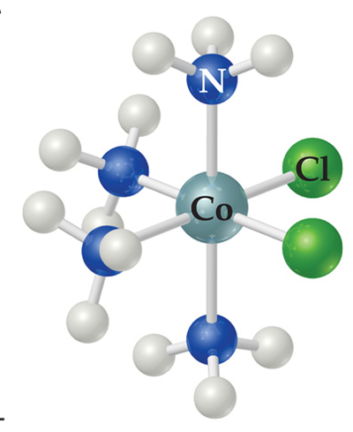
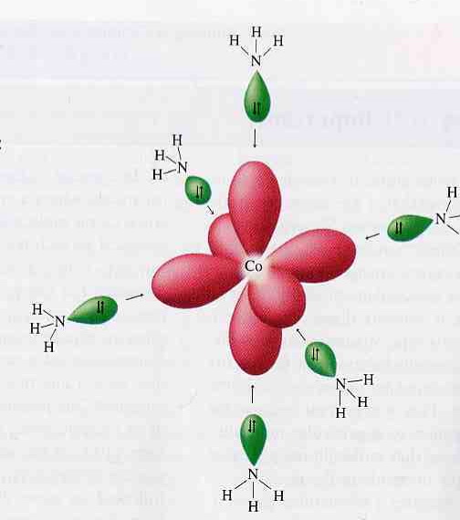
What is a coordination compound?
Coordination complex: A structure containing a metal (usually a metal ion) bonded (coordinated) to a group of surrounding molecules or ions (Ligand)
Coordination compounds have their ability to retain their identity in solution (which distinguishes them from double salts like Mohr’s salr- (FeSO₄.(NH₄)₂SO₄.6H₂O) and their properties are completely different from those of the constituents.
Ligand donates a lone pair of electrons (Lewis base) to make coordinate bond to the central metal ion (Lewis acid)
Coordination sphere- the group comprising the metal ion and the ligands
Coordination number- number of ligands bound to the central metal ion (or atom)
Lewis base
NH₃
Lewis acid
Co³⁺

Slide 3
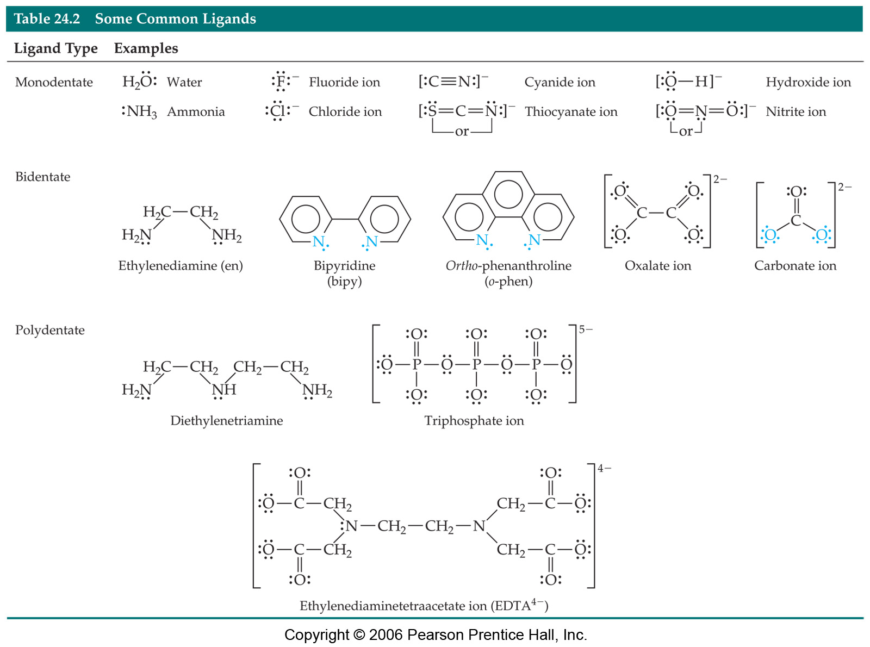
Types of Ligands:
Classified based on denticity (no. of donor atoms):
Monodentate, bidentate, tri…tetra…penta…..polydentate etc..

Slide 4
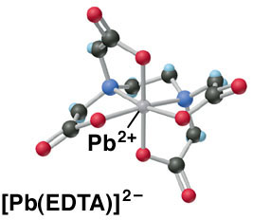
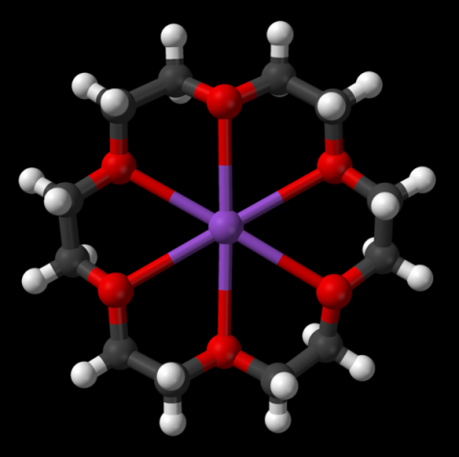
Chelating and Macrocyclic Ligands:
Chelating ligands (chelates) – ligands that have two or more points of attachment to the metal atom or ion.
Chelating agents generally form more stable complexes than do monodentate ligands.
A macrocycle is a cyclic macromolecule or a macromolecular cyclic portion of a molecule containing a ring of nine or more atoms
A macycocyclic ligand is a cyclic molecule with three or more potential donor atoms that can coordinate to a metal center
Macrocyclic ligands form more stable complexes than a linear, dipodal and tripodal ligands etc.
18-crown-6 coordinating a potassium ion

Slide 5
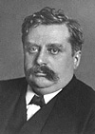
Alfred Werner: the father of the structure of coordination complexes
The Nobel Prize in Chemistry 1913
"in recognition of his work on the linkage of atoms in molecules by which he has thrown new light on earlier investigations and opened up new fields of research especially in inorganic chemistry"
Alfred Werner
Switzerland
University of Zurich
Zurich, Switzerland
b. 1866
(in Mulhouse, then Germany)
d. 1919

Slide 6
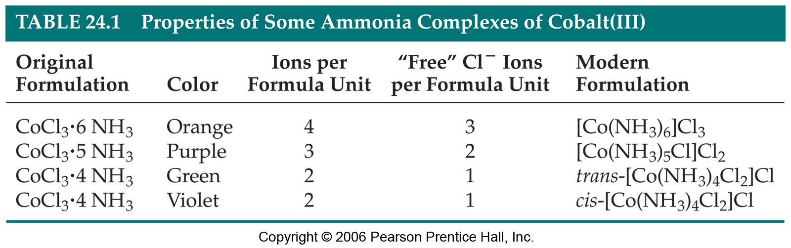
Werner’s Coordination Theory
In coordination compounds, the metal ions exhibited and satisfied by two types of valency for bonding: (i) Primary valency (oxidation state of metal ion)– positive charge of the metal ion is balanced by negative ions in the compound. It is ionizable and non-directional. (ii) Secondary valency (coordination number of metal ion)– molecules or ion (ligands) are attached directly to the metal ion. It is non-ionizable and directional.
Every metal has a fixed number of secondary valency i.e. it has a fixed coordination number.
Secondary valency directed towards fixed positions to give definite geomery of the coordination compounds

Slide 7
Conventions in writing the structure of coordination compounds:
Brackets [] are used to indicate all of the atomic composition of the coordinate complex: the central metal atom and the ligands. The symbol for the central metal atom of the complex is first within the brackets
(2) Species outside of the [] are not coordinated to the metal but are require to maintain a charge balance
[Co(NH₃)₆]³⁺
[Co(NH₃)₆]Cl₃
3 Cl⁻
Composition of complex
Free species

Slide 8
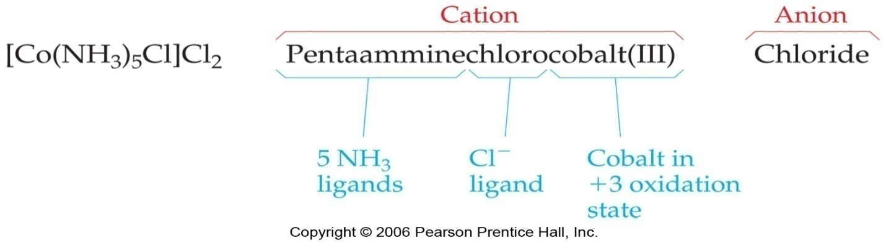
Nomenclature of Coordination Compounds
1.The cation is named first in ionic compounds, then the anion.
2.Nonionic compounds are given a one-word name.
3.The following rules pertain to the names of ligands:
a. The ligands are named first and the central atom last.
b. Ligands are named in alphabetical order by their root name.
c. Neutral ligands are named the same as the molecule, except for a few such as H₂O (aqua) and NH₃ (ammine), which have special names.
d. Anionic ligands are named by adding –o to the stem of the usual name, such as chloro for Cl⁻ and sulfato for SO₄^{2-.}
e. The name of each ligand is preceded by a Latin prefix (di-, tri- tetra-, penta, hexa- etc.) if more than one of that ligand Is bonded to the cetnral atom. For example, the ligands in PtCl₄²⁻ are named tetrachloro, and the ligands in Co(NH₃)₄Cl₂⁺ are named tetraamminedichloro.
If the ligand is polydentate, as in ethylenediamine, the number of ligands bonded to the central atom is indicated by the corresponding Greek prefixes (bis-, tris-, tetrakis-, pentakis-, hexakis-, etc.).
For example, the ligands in Co(en)₃³⁺ are named trisethylenediamine.

Slide 9
4. For a cationic complex ion or a nonionic compound, the central atom is given its ordinary name followed by its oxidation number in Roman numerals, enclosed in parentheses.
For example, [Cr(H₂O)₅Cl]²⁺ is named pentaaquachlorochromium(III) ion, and [Cr(NH₃)₃Cl₃] is name triamminetrichlorochromium (III).
5. For anionic complex ions, the suffix –ate is added to the name of the central atom, followed by the oxidation number in Roman numerals, enclosed in parentheses.
For example, [Cr(CN)₆]³⁻ is name hexacyanochromate (III) ion.
For metals with Latin names, the negatively charge complex uses: ferrate (for Fe) argentate (for Ag) plumbate (for Pb) stannate (for Sn) aurate (for Au) cuprate (for Cu)

Slide 10
Formulas and Name of Some Common Ligands
Formula Name
H₂O aqua
NH₃ ammine
CO carbonyl
NO nitrosyl
H₂NC₂H₄NH₂ ethylenediamine
OH⁻ hydroxo
O²⁻ oxo
F⁻ fluoro
Cl⁻ chloro
Br⁻ bromo
I⁻ iodo
CN⁻ cyano
-NCS⁻ isothiocyanato*
-SCN⁻ thiocyanato*
SO₄²⁻ sulfato
SO₃²⁻ sulfito
NO₃⁻ nitrato*
-NO₂⁻ nitro*
-ONO⁻ nitrito*
CO₃²⁻ carbonate
*In these ligands two forms are known; they differ in the atom that donates the electron pair to the metal ion.

Slide 11
Practice problem_1
Name the following complex ions.
a. [Ru(NH₃)₅Cl]²⁺
b. [Fe(CN)₆]⁴⁻
c. [Mn(NH₂CH₂CH₂NH₂)₃]²⁺
d. [Co(NH₃)₅NO₂]²⁺
Name the following coordination compounds.
a. [Co(NH₃)₆]Cl₂
b. [Co(H₂O)₆]I₃
c. K₂[PtCl₄]
d. K₄[PtCl₆]
Give the formulas for the following.
a. Hexakispyridinecobalt(III)chloride
b. Pentaammineiodochromium(III) iodide
c. Trisethylenediamminenickel(II)bromide
d. Potassium tetracyanonickelate(II)

Slide 12
Effective Atomic Number (EAN):
EAN for complex = (atomic number - ion charge) + (number of ligands X number of electrons per ligands)
Stability was assumed to be attendant to a noble gas configuration. EAN rule stated that the sum total of all of the electrons would have the configuration of a noble gas.
Exa. [Co(NH₃)₆]³⁺ : (27-3) + 6X2 = 36 electrons
[Ni(CO)4]; [Fe(CN)₆]⁴⁻
Many stable complexes are known which don’t obey EAN rule.
Exa. [Fe(CN)₆]³⁻ (35 electrons)
[Cr(NH₃)₆]³⁺ (33 electrons)

Slide 13
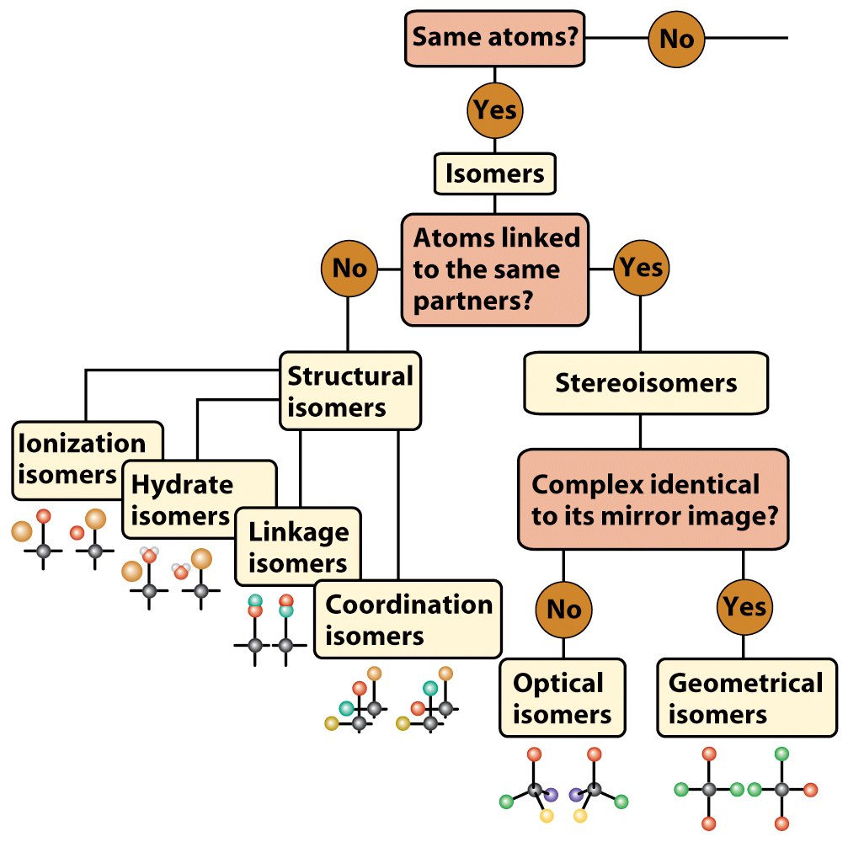
Isomers of Coordination Compounds:
Different composition!
Isomers have the same molecular formula, but their atoms are arranged either in a different order (structural isomers) or spatial arrangement (stereoisomers).
Cis-trans
Optical
(Enantiomers)

Slide 14
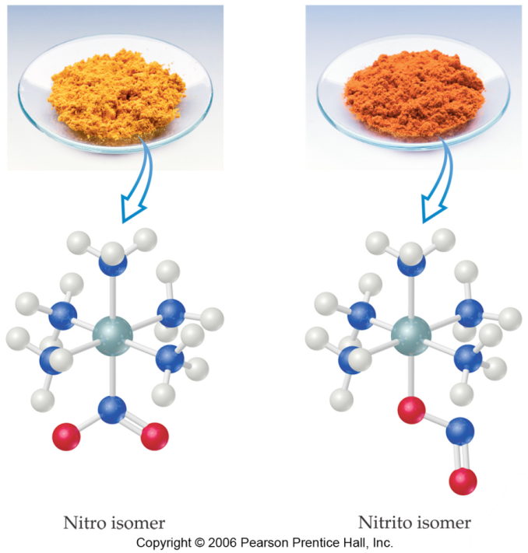
Structural Isomers…..
  Linkage isomer: If an ambidentate ligand (like the NO₂ group at the bottom of the complex) can bind to the metal with one or another atom as the donor atom, linkage isomers are formed.
  Ex. [Co(NO₂)(NH₃)₅]Cl₂ and
  [Co(ONO)(NH₃)₅]Cl₂
  Coordination isomer: Observed with complex consisting of both cationic and anionic complexes.
  Ex. [Co(NH3)6][Cr(CN)6] and [Cr(NH3)6][Co(CN)6]
  [Cr(NH3)6][Cr(CN)6] and [Co(NH3)4(CN)2][Cr(CN)4(NH3)2]

Slide 15
Structural Isomers……
Ionization isomerism: some isomers differ in what ligands are bonded to the metal and what is outside the coordination sphere.
Ex. [CoBr(NH₃)₅]SO₄ and [Co(SO₄)(NH₃)₅]Br
Hydrate Isomerism: Similar to ionization isomerism (arises from the replacement of coordinated water)
Ex. three isomers of CrCl₃(H₂O)₆ are
  The violet [Cr(H₂O)₆]Cl₃,
  The green [Cr(H₂O)₅Cl]Cl₂ ∙ H₂O, and
  The (also) green [Cr(H₂O)₄Cl₂]Cl ∙ 2 H₂O.

Slide 16
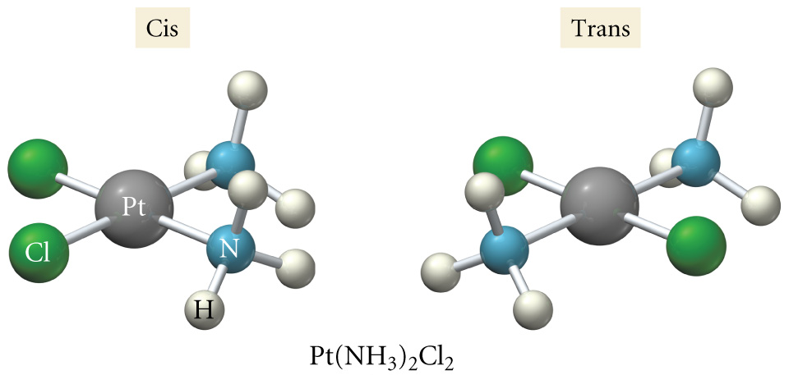
Stereoisomers: Geometric isomerisms…..
[PtCl₂(NH₃)₂]
In geometrical isomerism, ligands occupied different positions around the central metal ion.
Exa. With these geometric isomers, two chlorines and two NH₃ groups are bonded to the platinum metal, but are clearly different. (Note: one form never be converted to other without breaking a bond)
  cis-Isomers have like groups on the same side.
  trans-Isomers have like groups on opposite sides.

Slide 17
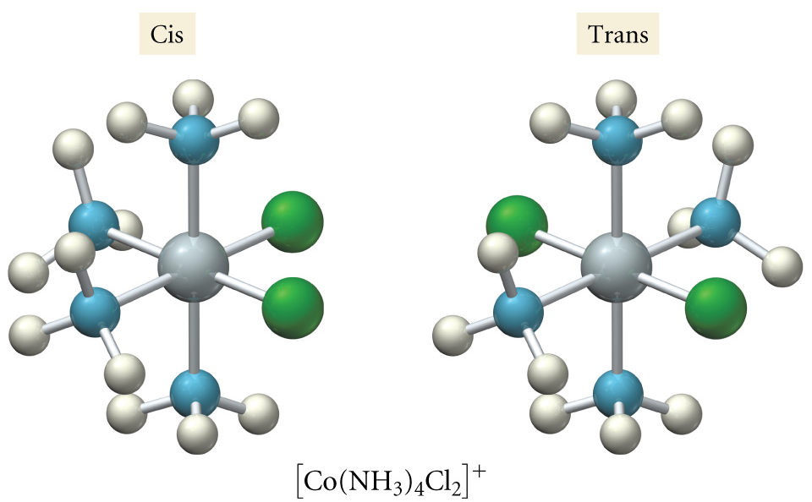
Stereoisomers: geometric isomers (cis and trans)
In octahedral complexes, the prefixes cis and trans are used for complexes of the form [MX₄Y₂]

Slide 18
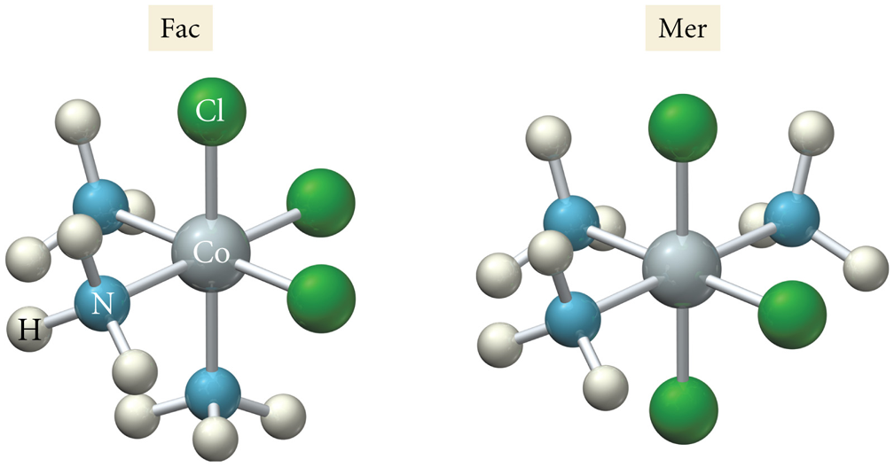
Geometric isomers: cis (fac) and trans (mer)
For complexes with the formula [MX₃Y₃], there are two spatial arrangements of the ligands.
fac stands for facial (three identical ligands occupying the corners of a common triangular)
mer stands for meridional (three identical ligands occupying three consecutive corners of a square plane)

Slide 19
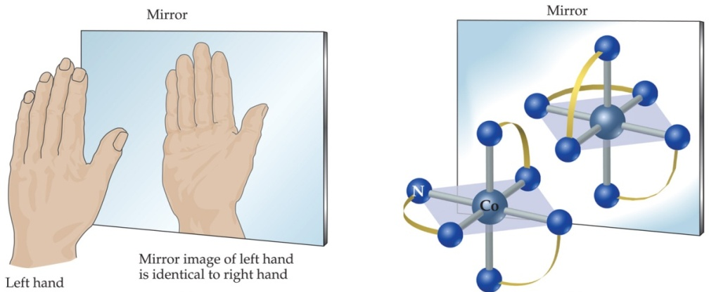
Optical isomers: Enantiomers
Mirror images are either superimposible or they are not…Enantiomers are mirror images which are not superimposable.
Enantiomers do not have a plane of symmetry
Enantiomers rotate polarized light in different directions; therefore, enanotiomers are also termed “optical isomers”
Any molecule which possesses a plane of symmetry is superimposable on its mirror image

Slide 20
Enantiomers: non superimposable mirror images
A molecule possessing a plane of symmetry is achiral and a superimposible on its mirror image……Enantiomers are NOT possible
A structure is termed chiral if it is not superimposable on its mirror image
Are the following chiral or achiral structures?
Plane of symmetry
Achiral (one structure)
No plane of symmetry
Chiral (two enantiomer)
non superimposable mirror images

Slide 21
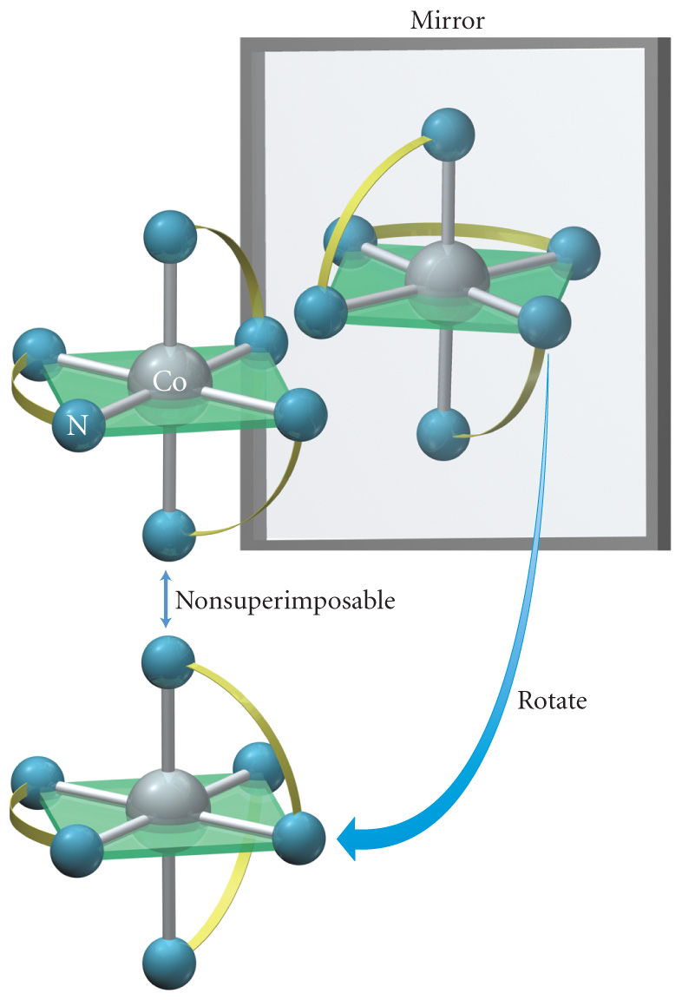
Optical Isomers: Possible in Octahedral complexes containing polydentate ligands can form optical isomers. Complexes with three rings, such as [Co(en)₃]³⁺,
The right-handed isomer requires going clockwise to get from the upper triangle to the lower one. The prefix for this isomer is ∆.
The left-handed isomer requires going counterclockwise to get from the upper triangle to the lower one. The prefix for this isomer is Λ.

Slide 22
Bonding in Coordination Compounds:
Following theories were introduced to explain the bonding in coordination compounds:
Valence bond theory (VBT)
Crystal field theory (CFT)
Molecular orbital theory (MOT)

Slide 23
Valence Bond Theory
Proposed by Pauling, explain with reasonable success, the formation magnetic behaviour and geometry of the complexes. However, It fails to provide quantitative interpretation of magnetic behaviour and also say nothing about the optical properties of complexes.
According to VBT….
The empty orbitals of central metal atom [ns, np and (n-1)d or nd] undergo hybridization and form a set of hybride orbitals of equal energy to accommodate the electrons pairs donated by ligands.
The ‘d’ orbitals involved in the hybridization may be inner (n-1)d (low spin) or the outer nd (high spin).
Atomic Orbital Set Hybrid Orbital Set Electronic Geometry
s, p Two sp Linear
s, p, p Three sp² Trigonal Planar
s, p, p, p Four sp³ Tetrahedral
s, p, p, p, d Five sp³d Trigonal Bipyramidal
s, p, p, p, d, d Six sp³d² Octahedral

Slide 24
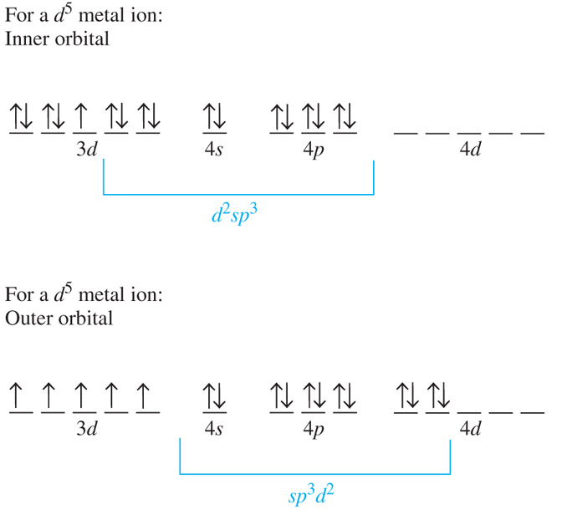
Examples of some electrons rearrangement and orbital mixing to give hybride orbitals

Slide 25
Valence Bond Theory
:
3d
4s
4p
4d
d²sp³
octahedral
if complex is diamagnetic
Example 1: [Co(NH₃)₆]³⁺
Co [Ar] 3d⁷ 4s²
Co³⁺ [Ar] 3d⁶

Slide 26
Example 2: [CoF₆]^{3–}
Co [Ar] 3d⁷ 4s²
Co³⁺ [Ar] 3d⁶
3d
4s
4p
4d
4sp³d²
if complex is paramagnetic
octahedral
Q1. Hexaamminechromium(III) ion a yellow complex is paramagnetic, use valence bond theory to explain the bonding and magnetic properties of the complex.
[Cr(NH₃)₆]³⁺

Slide 27
Example 3: [Ni(CN)₄]^{2–}, diamagnetic
Pt²⁺ [Xe] 4f¹⁴ 5d⁸
5d
6s
6p
square planar
dsp²
Example 4: [NiCl₄]^{2–}, tetrahedral
Ni²⁺ [Ar] 3d⁸
3d
4s
4p
paramagnetic
4sp³

Slide 28
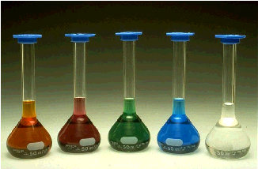
Crystal Field Theory (CFT):
Basis: purely electrostatic interaction. There is no interaction between metal orbitals and ligands orbitals.
In crystal field theory, the electron pairs on the ligands are viewed as point negative charges that interact with the d-orbitals on the central metal.
Splitting of metal d-orbitals
It can explain optical properties, magnetism and reactivity
[Fe(H₂O)₆]³⁺
[Ni(H₂O)₆]³⁺
[Zn(H₂O)₆]³⁺
[Co(H₂O)₆]³⁺
[Cu(H₂O)₆]³⁺

Slide 29
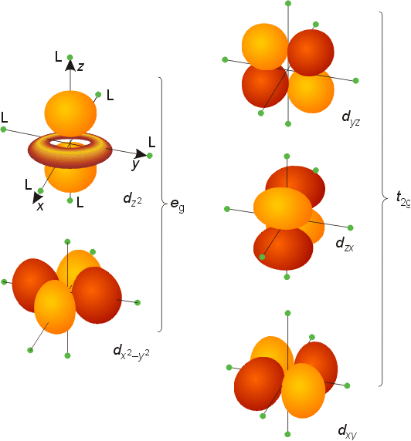
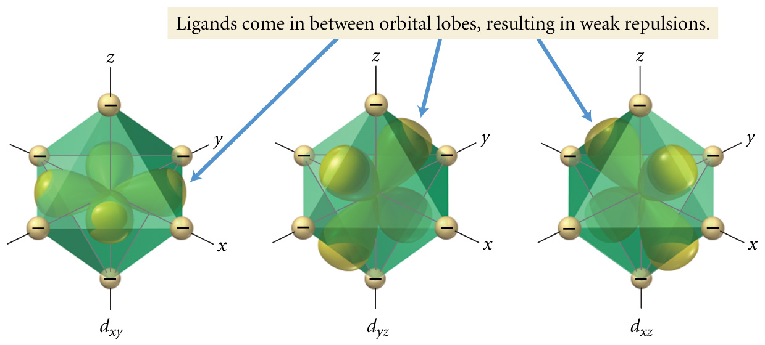
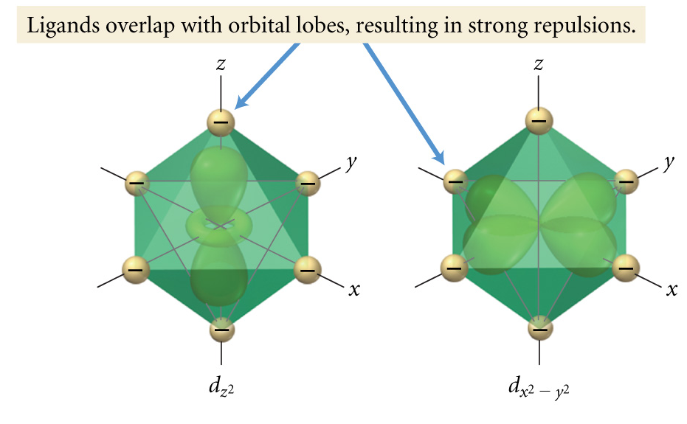
•
•
What will happen when six ligands approach from the six vertices of an octahedron?
•
The five d-orbitals in an octahedral field of ligands.
•
•
•
Ligands, viewed as point charges, at the corners of an octahedron affect the various d orbitals differently.
The repulsion between ligand lone pairs and the d orbitals on the metal results in a splitting of the energy of the d orbitals.

Slide 30
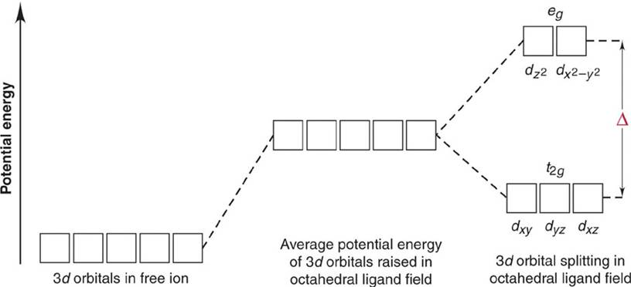
Splitting of d-orbital energies by an octahedral field of ligands.
The splitting of orbital energies is called the crystal field effect, and the energy difference between the e_{g} and the t_{2g} orbitals is called the crystal field splitting energy (CFSE). It is represented by symbols Δ_{o} or 10 Dq.

Slide 31
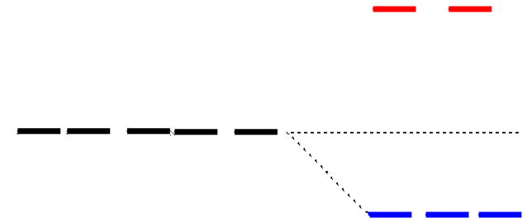
Splitting of d-orbitals in an octahedral field
e_{g}
3/5 Δo
Δo = 10 Dq
2/5 Δo
t_{2g}
E(t_{2g}) = -0.4Δo x 3 = -1.2Δo
E(e_{g}) = +0.6Δo x 2 = +1.2Δo
CFSE (Δo) = -0.4n(t2g) + 0.6n (eg), n represents number of electron in t2g and eg
In some texts and articles, the gap in the d orbitals is assigned a value of 10Dq. The upper (e_{g}) set goes up by 6Dq, and the lower set (t_{2g}) goes down by 4Dq. The actual size of the gap varies with the metal and the ligands.
Notes:
31

Slide 32
Electron Configuration in d-Orbitals
Δ
Hund’s rule
pairing energy considerations
Δ > Pairing energy
low spin d⁴
^{Strong field}
Δ < Pairing energy
high spin d⁴
^{Weak Field}
Factors affecting magnitude of Δ
Nature of the ligands
Oxidation state of the metal ion
Nature of the metal ion
Number and geometry of the ligands

Slide 33
The magnitude of the splitting (ligand effect)
Weak-field ligands (which have a small Δ) tend to favor adding electrons to the higher-energy orbitals (high-spin complexes) because Δ is less than the spin-pairing energy.
Strong-field ligands (which have a large Δ) tend to favor adding electrons to lower-energy orbitals (low-spin complexes) because Δ is greater than the spin-pairing energy.
The Spectrochemical Series
Small Δ
Weak field ligands
Large Δ
Strong field ligands
Notes:
33

Slide 34
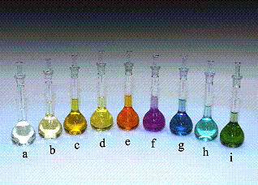
The Spectrochemical Series……
The complexes of cobalt (III) show the shift in color due to the ligand.
(a) CN–, (b) NO₂–, (c) phen, (d) en, (e) NH₃, (f) gly, (g) H₂O, (h) ox^{2–}, (i) CO₃ ^{2–}.
Note: Confirmation of d-orbital splitting from the broader range in colors of transition metal complexes

Slide 35
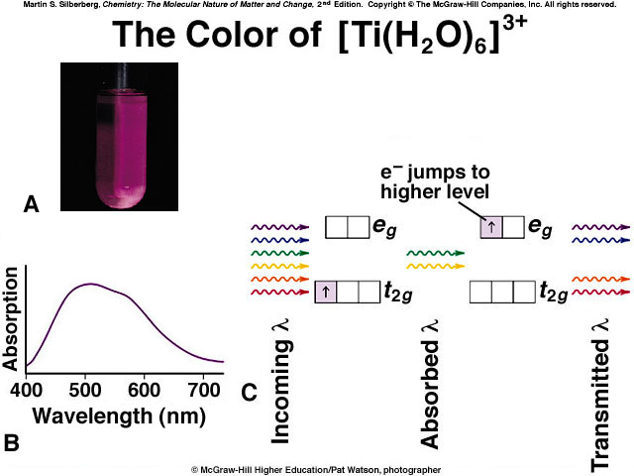
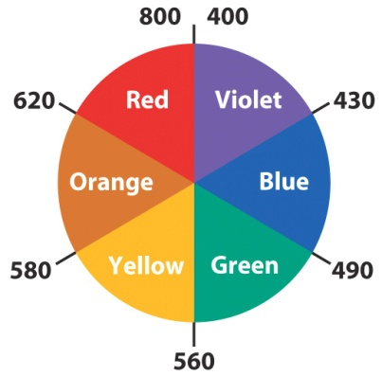
d-Orbital Splitting and Color:
The colors exhibited by most transition metal complexes arises from the splitting of the d orbitals. As electrons transition from the lower t_{2g} set to the e_{g} set, light in the visible range is absorbed.
The color that we see is the color that is not absorbed, but is transmitted. The transmitted light is the complement of the absorbed light. So if red light is mainly absorbed the color is green; if green light is mainly absorbed, the color is red.
Numbers are nm

Slide 36
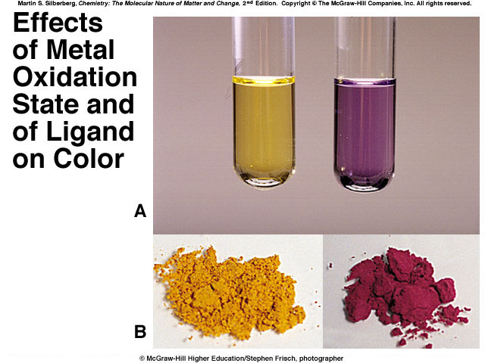
[V(H₂O)₆]²⁺
[V(H₂O)₆]³⁺
[Cr(NH₃)₆]³⁺
[Cr(NH₃)₅Cl]^{2+s}

Slide 37
The magnitude of the splitting (metal ion effect)
∆_{o} increases with increasing oxidation number on the metal.
Mn⁺²<Ni⁺²<Co⁺²<Fe⁺²<V⁺²<Fe⁺³<Co⁺³
<Mn⁺⁴<Mo⁺³<Rh⁺³<Ru⁺³<Pd⁺⁴<Ir⁺³<Pt⁺⁴
∆_{o} increases with increases going down a group of metals.
Notes:
37

Slide 38
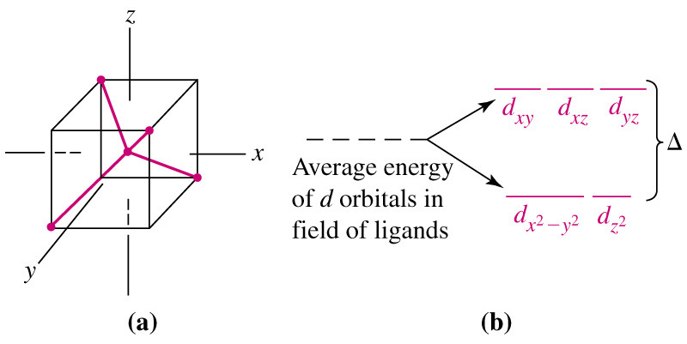
Splitting of d-orbitals in a tetrahedral field
Because there are only 4 ligands, Δ for a tetrahedral field is smaller than Δ for an octahedral field.
Always weak field (high spin)
Δ_{t} = 4/9Δ_{o}
Notes:
38

Slide 39
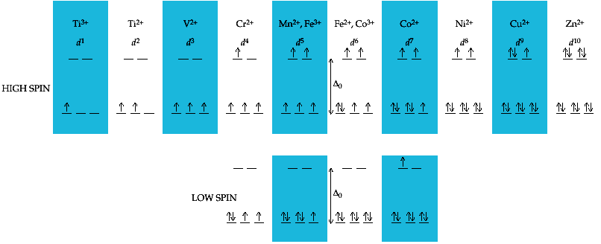
High Spin Vs. Low Spin (d¹ to d¹⁰) and Magnetism
Electron Configuration for Octahedral complexes of metal ion having d¹ to d¹⁰ configuration [M(H₂O)₆]^{+n}.
Only the d⁴ through d⁷ cases have both high-spin and low spin configuration.
Electron configurations for octahedral complexes of metal ions having from d¹ to d¹⁰ configurations. Only the d⁴ through d⁷ cases have both high-spin and low-spin configurations.

Slide 40
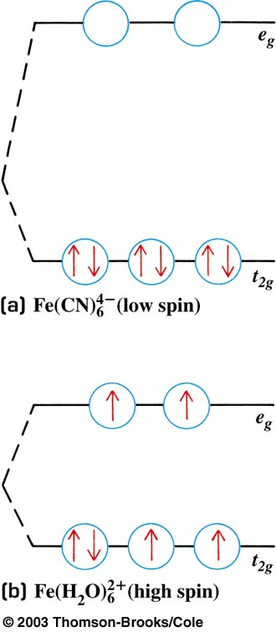
Crystal Field Splitting of d orbitals: high spin and low spin situations for a d⁶ metal
Ligand strength: (Weak) I⁻ < F⁻ < H₂O < NH₃ < CN⁻ (Strong)
Low spin
Electrons spin
pair
Net unpaired
spins = 0:
Diamagnetic
Large splitting
Net unpaired
spins = 4:
Strongly paramagnetic
High spin
Electrons do
Not spin pair
Small splitting

Slide 41
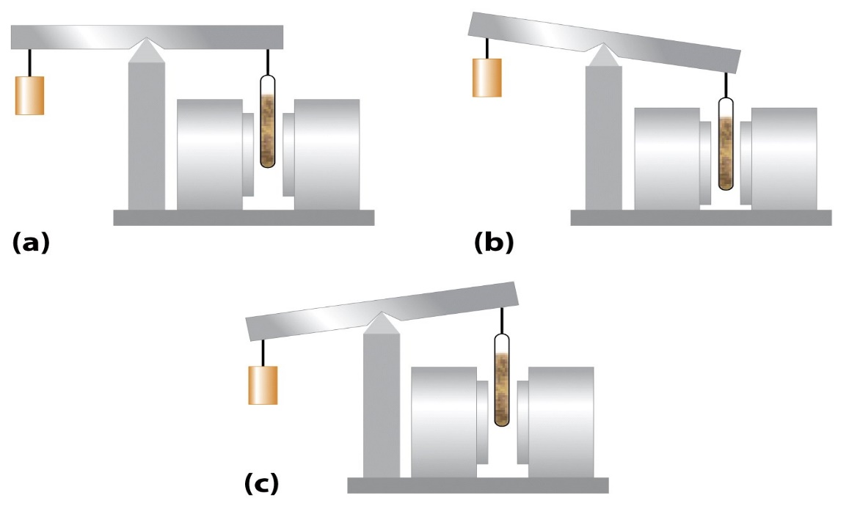
Magnetism in metal complexes:
Diamagnetic complexes very small repulsive interaction with external magnetic field (no unpaired electrons)
Paramagnetic complexes attractive interaction with external magnetic field (some unpaired electrons)
Magnet off
Magnet on:
Paramagnetic
Magnet on:
diamagnetic
Guoy balance
The magnetic moment of a substance, in Bohr magnetons (BM), can be related to the number of unpaired electrons in the compound (‘spin only’ formula).
μ_{s} = [n(n+2)]1/2
Where n is the number of unpaired electrons
Notes:
41

Slide 42
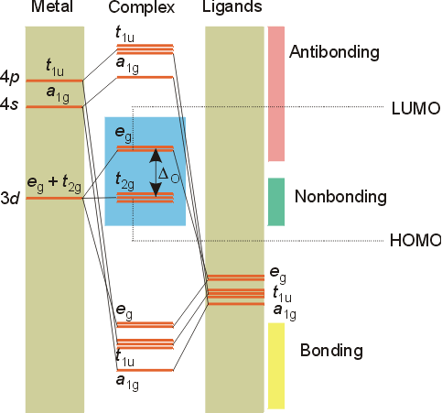
Molecular orbitals theory for metal complexes:
The molecular orbital diagram is consistent with the crystal field approach. Note that the t_{2g} set of orbitals is non-bonding, and the e_{g} set of orbitals is antibonding.
The electrons from the 4s and 3d orbitals of the metal (in the first transition row) will occupy the middle portion of the diagram.
{
The electrons from the ligands (12 electrons from 6 ligands in octahedral complexes) will fill the lower bonding orbitals.
Notes:
42

Slide 43
π-bonding may be introduced
as a perturbation of the t_{2g}/e_{g} set:
Case 1 (CN⁻, CO, C₂H₄)
empty π-orbitals on the ligands
M→L π-bonding (π-back bonding)
Strong field / low spin
t_{2g} (π*)
t_{2g}
e_{g}
e_{g}
Δo
Δ’o
Δ_{o} has increased
t_{2g}
Stabilization
t_{2g} (π)
ML₆
σ-only
ML₆
σ + π
(empty π-orbitals on ligands)

Slide 44
π-bonding may be introduced
as a perturbation of the t_{2g}/e_{g} set.
Case 2 (Cl⁻, F⁻)
filled π-orbitals on the ligands
L→M π-bonding
Weak field / high spin
e_{g}
e_{g}
Δ’o
t_{2g} (π*)
Δ_{o} has decreased
Δo
Destabilization
t_{2g}
t_{2g}
Stabilization
t_{2g} (π)
ML₆
σ-only
ML₆
σ + π
(filled π-orbitals)

Slide 45
Applications of coordination compounds
The coordination compounds are of great importance. These compounds are widely present in the mineral, plant and animal worlds and are known to play many important functions in the area of:
  Analytical chemistry (environmental),
  Metallurgy,
  Biological systems,
  Industry
  Medicine.

Slide 46
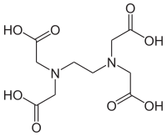
Applications of coordination compounds
Ethylenediaminetetraacetic acid (EDTA) is used for estimation of Ca²⁺ and Mg²⁺ in hard water
Use in many qualitative and quantitative chemical analyses.
Purification of metal can be achieved through formation and sub sequence decomposition of their coordination compounds.
Importance and applications of coordination compounds are of great importance in biological system.
There is growing interest in the user of chelate therapy in medicinal chemistry. Excess of copper and iron are removed by chelating ligands D-penicillamine and desferrioxime B via the formation of the coordination compounds. EDTA is used in the treatment of lead.
Coordination compounds are used as catalysts for many industrial processes.

Slide 47
Coordination Complexes in Living Systems
Some critical enzymes in our cells are metalloproteins, giant biolmolecules which contain a metal atom. These metalloproteins control key life processes such as respiration and protect cells against diseases.
Fourteen essential elements: Na, K, Ca, Mg, V, Cr, Mn, Fe, Co, Ni, Cu, Ni, Cu, Zn, Mo and Cd.
Metals (Exa. Cu²⁺, Zn²⁺ etc) are present in the active sites of proteins and enzymes, plays specific roles
Hemoglobin is a metalloprotein which contains an iron atom and transports O2 through out living systems
Exa. Hemoglobin is the iron-containing oxygen-transport metalloprotein in the red blood cells, which carries oxygen from the respiratory organs (lungs or gills) to the rest of the body (i.e. the tissues) where it releases the oxygen to burn nutrients to provide energy to power the functions of the organism, and collects the resultant carbon dioxide to bring it back to the respiratory organs to be dispensed from the organism.
Notes:
47

Slide 48
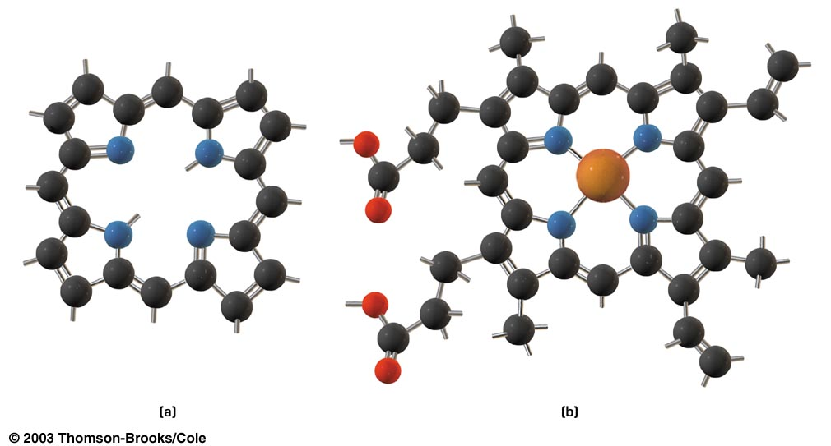
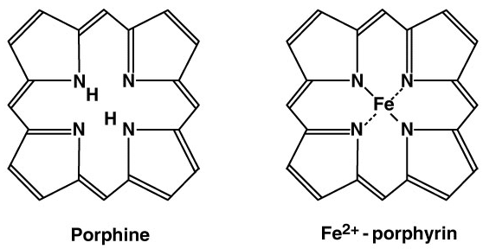
Porphines and hemes: important molecules in living systems
These planar molecules have a “hole” in the center which to which a metal can coordinate
Porphine (C₂₀H₁₄N₄)₎
heme (C₃₄H₃₂N₄O₄Fe)₎
Porphines, hemes, hemoglobin
Notes:
48

Slide 49
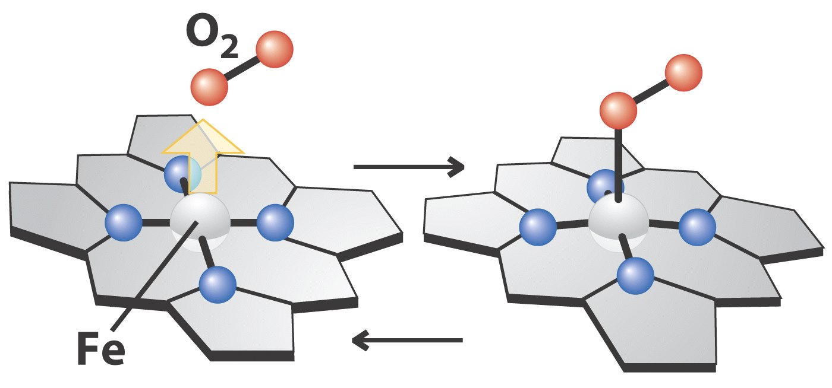
Reversible addition of O₂ to hemoglobin
The mechanism by which oxygen is carried throughout the body
Notes:
49

Slide 50
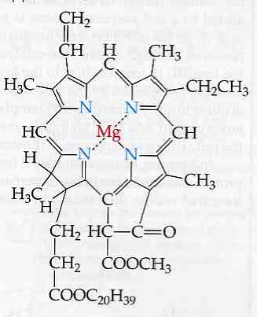
A very important porphine that converts solar photons into food energy: chlorophyll
Chlorophyll is vital for photosynthesis, which allows plants to obtain energy from light.
6CO2 + 6H2O C6H12O6 + 6O2
The function of the vast majority of chlorophyll is to absorb light and transfer that light energy to the reaction center of the photosystems.
Mg²⁺ helps to make the entire molecule rigid so that energy is not too easily lost thermally, and enhance the transformation of short life S₁ to T₁ state.
Chlorophyll (C₅₅H₇₂N₄O₅Mg)
Notes:
50

Slide 51
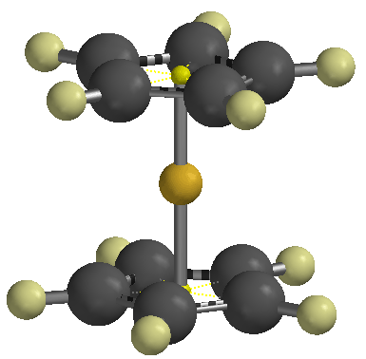
Organmetallic Compounds
Organometallic compound: A compound that contains a carbon-metal bond.
Classification
R–Mg–X
Grignard reagent
(CH₃)₃Al
Trimethyl aluminium
(CH₃CH₂)₂Zn
Diethylzinc
(CH₃)₂Cd
Dimethyl cadmium

Slide 52
Bonding in carbonyls
Donation of lone pair of electrons on the carbonyl carbon into a vacant orbital of the metal.
π-electron density of the alkene overlaps with a σ-type vacant orbital on the metal atom
donation of a pair of electrons from a filled d-orbital of metal into vacant antibonding (π*) orbital of CO (back bonding).

Slide 53
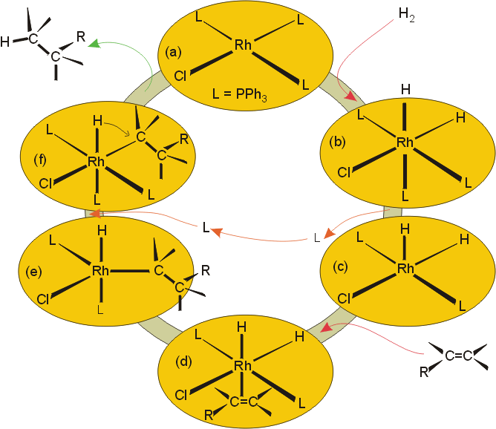
Organometallics and catalysis:
Organometallics are often involved as catalysis for reactions. The complexes can undergo addition of organic molecules or hydrogen, and then be regenerated as the organic product is released from coordination to the catalyst.
Wilkinson’s catalyst, (Ph₃P)₃RhCl, used in hydrogenation of alkenes.
Ziegler-Natta catalyst, [(C₂H₅)₃AlTiCl₄], for the polymerization of alkenes.

Slide 54
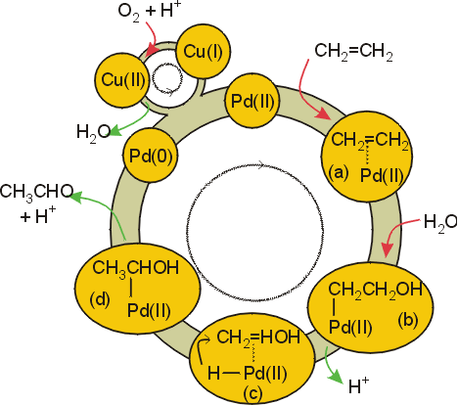
Catalysis – aldehyde formation
Pd(II) undergoes addition of an alkene which is subsequently converted to an alcohol. Addition of a hydrogen atom to the metal with subsequent migration to the alcohol produces an aldehyde.

Slide 55
THANKS

