Slide 1
Dr Suban K Sahoo MSc, NET (JRF), PhD
Surface chemistry
Types of adsorption, adsorption isotherms-Freundlich and Langmuir;
Colloids and colloids state, application of colloids,
Surfactants, micelles, critical micelle concentration,
Basics of surface, characterization by X-Ray and DLS.

Slide 2
Adsorption
The accumulation of molecular species at the surface rather than in the bulk of a solid or liquid is termed adsorption.
The molecular species or substance, which concentrates or accumulates at the surface is termed adsorbate and the material on the surface of which the adsorption takes place is called adsorbent.

Slide 3
Action of adsorption
(i) If a gas like O₂, H₂, CO, Cl₂, NH₃ or SO₂ is taken in a closed vessel containing powdered charcoal, it is observed that the pressure of the gas in the enclosed vessel decreases. The gas molecules concentrate at the surface of the charcoal, i.e., gases are adsorbed at the surface.
(ii) In a solution of an organic dye, say methylene blue, when animal charcoal is added and the solution is well shaken, it is observed that the filtrate turns colourless. The molecules of the dye, thus, accumulate on the surface of charcoal, i.e., are adsorbed.
(iii) Aqueous solution of raw sugar, when passed over beds of animal charcoal, becomes colourless as the colouring substances are adsorbed by the charcoal.
(iv) The air becomes dry in the presence of silica gel because the water molecules get adsorbed on the surface of the gel.
The process of removing an adsorbed substance from a surface on which it is adsorbed is called desorption.

Slide 4
Difference between adsoprtion and absorption
In adsorption, the substance is concentrated only at the surface and does not penetrate through the surface to the bulk of the adsorbent, while in absorption the substance is uniformly distributed throughout the bulk of the solid.
A distinction can be made between absorption and adsorption by taking an example of water vapour. Water vapours are absorbed by anhydrous calcium chloride but adsorbed by silica gel.
In other words, in adsorption the concentration of the adsorbate increases only at the surface of the adsorbent, while in absorption the concentration is uniform throughout the bulk of the solid.
Both adsorption and absorption can take place simultaneously also. The term sorption is used to describe both the processes.

Slide 5
Mechanism of adsoprtion
Inside the adsorbent all the forces acting between the particles are mutually balanced but on the surface the particles are not surrounded by atoms or molecules of their kind on all sides, and hence they possess unbalanced or residual attractive forces.
These forces of the adsorbent are responsible for attracting the adsorbate particles on its surface. The extent of adsorption increases with the increase of surface area per unit mass of the adsorbent at a given temperature and pressure.

Slide 6
Another important factor featuring adsorption is the heat of adsorption. During adsorption, there is always a decrease in residual forces of the surface, i.e., there is decrease in surface energy which appears as heat.
Adsorption, therefore, is invariably an exothermic process. In other words, ∆H of adsorption is always negative. When a gas is adsorbed, the freedom of movement of its molecules become restricted. This amounts to decrease in the entropy of the gas after adsorption, i.e., ∆S is negative.
Adsorption is thus accompanied by decrease in enthalpy as well as decrease in entropy of the system. For a process to be spontaneous, the thermodynamic requirement is that, at constant temperature and pressure, ∆G must be negative, i.e., there is a decrease in Gibbs energy.
On the basis of equation, ∆G = ∆H – T∆S, ∆G can be negative if ∆H has sufficiently high negative value as – T∆S is positive. Thus, in an adsorption process, which is spontaneous, a combination of these two factors makes ∆G negative.
As the adsorption proceeds, ∆H becomes less and less negative ultimately ∆H becomes equal to T∆S and ∆G becomes zero. At this state equilibrium is attained.

Slide 7
Types of adsorption
There are mainly two types of adsorption of gases on solids. If accumulation of gas on the surface of a solid occurs on account of weak van der Waals’ forces, the adsorption is termed as physical adsorption or physisorption.
When the gas molecules or atoms are held to the solid surface by chemical bonds, the adsorption is termed chemical adsorption or chemisorption.
The chemical bonds may be covalent or ionic in nature. Chemisorption involves a high energy of activation and is, therefore, often referred to as activated adsorption.
Sometimes these two processes occur simultaneously and it is not easy to ascertain the type of adsorption. A physical adsorption at low temperature may pass into chemisorption as the temperature is increased. For example, dihydrogen is first adsorbed on nickel by van der Waals’ forces.
Molecules of hydrogen then dissociate to form hydrogen atoms which are held on the surface by chemisorption.

Slide 8
Characteristics of physisorption
(i) Lack of specificity: A given surface of an adsorbent does not show any preference for a particular gas as the van der Waals’ forces are universal.
(ii) Nature of adsorbate: The amount of gas adsorbed by a solid depends on the nature of gas. In general, easily liquefiable gases (i.e., with higher critical temperatures) are readily adsorbed as van der Waals’ forces are stronger near the critical temperatures.
(iii) Reversible nature: Physical adsorption of a gas by a solid is generally reversible. Thus, More of gas is adsorbed when pressure is increased as the volume of the gas decreases and the gas can be removed by decreasing pressure. Since the adsorption process is exothermic, the physical adsorption occurs readily at low temperature and decreases with increasing temperature (Le-Chatelier’s principle).
(iv) Surface area of adsorbent: The extent of adsorption increases with the increase of surface area of the adsorbent. Thus, finely divided metals and porous substances having large surface areas are good adsorbents.
(v) Enthalpy of adsorption: No doubt, physical adsorption is an exothermic process but its enthalpy of adsorption is quite low (20– 40 kJ mol⁻¹). This is because the attraction between gas molecules and solid surface is only due to weak van der Waals’ forces.

Slide 9
Characteristics of chemisorption
(i) High specificity: Chemisorption is highly specific and it will only occur if there is some possibility of chemical bonding between adsorbent and adsorbate.
(ii) Irreversibility: As chemisorption involves compound formation, it is usually irreversible in nature.
NOTE: Chemisorption is also an exothermic process but the process is very slow at low temperatures on account of high energy of activation. Like most chemical changes, adsorption often increases with rise of temperature. Physisorption of a gas adsorbed at low temperature may change into chemisorption at a high temperature. Usually high pressure is also favourable for chemisorption.

Slide 10
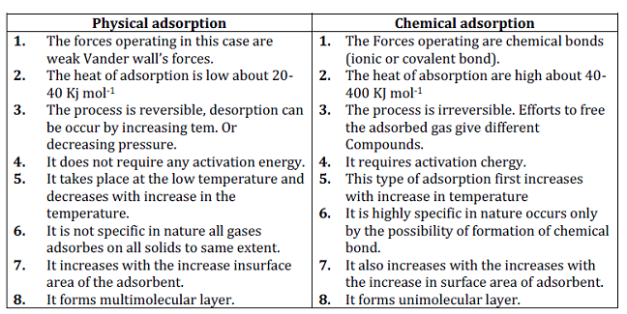
(iii) Surface area: Like physical adsorption, chemisorption also increases with increase of surface area of the adsorbent.
(iv) Enthalpy of adsorption: Enthalpy of chemisorption is high (80-240 kJ mol-1) as it involves chemical bond formation.

Slide 11
Adsorption isotherms
The variation in the amount of gas adsorbed by the adsorbent with pressure at constant temperature can be expressed by means of a curve termed as adsorption isotherm.
Freundlich adsorption isotherm: Freundlich, in 1909, gave an empirical relationship between the quantity of gas adsorbed by unit mass of solid adsorbent and pressure at a particular temperature.
A mathematical equation, which describes the relationship between pressure (p) of the gaseous adsorbate and the extent of adsorption at any fixed temperature, is called adsorption isotherms.
The extent of adsorption is expressed as mass of the adsorbate adsorbed on one unit mass of the adsorbent.

Slide 12
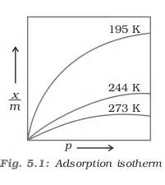
Thus, if x g of an adsorbate is adsorbed on m g of the adsorbent, then
where x is the mass of the gas adsorbed on mass m of the adsorbent at pressure P, k and n are constants which depend on the nature of the adsorbent and the gas at a particular temperature.
The relationship is generally represented in the form of a curve where mass of the gas adsorbed per gram of the adsorbent is plotted against pressure .
These curves indicate that at a fixed pressure, there is a decrease in physical adsorption with increase in temperature. These curves always seem to approach saturation at high pressure.

Slide 13
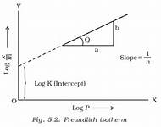
Taking log on both sides of equation we get
The validity of Freundlich isotherm can be verified by plotting log x/m on y-axis (ordinate) and log p on x-axis (abscissa).
If it comes to be a straight line, the Freundlich isotherm is valid, otherwise not . The slope of the straight line gives the value of 1/n . The intercept on the y-axis gives the value of log k.
Freundlich isotherm explains the behaviour of adsorption in an approximate manner. The factor 1 can have values between 0 and 1 . Thus, above equation holds good over a limited range of pressure.

Slide 14
When 1/n = 0, x/m = constant, the adsorption is independent of pressure.
When 1/n = 1, x/m = k p, i.e. x ∝ p, the adsorption varies directly with pressure.
Both the conditions are supported by experimental results. The experimental isotherms always seem to approach saturation at high pressure.
This cannot be explained by Freundlich isotherm. Thus, it fails at high pressure.

Slide 15
Adsorption from solution phase
Solids can adsorb solutes from solutions also. When a solution of acetic acid is shaken with charcoal a part of it is adsorbed by charcoal and the concentration of the acid decreases in the solution. The following observations have been made in the case of adsorption from solution phase:
(i) The extent of adsorption decreases with an increase in temperature.
(ii) The extent of adsorption increases with an increase of surface area of the adsorbent.
(iii) The extent of adsorption depends on the concentration of the solute in solution.
(iv) The extent of adsorption depends on the nature of the adsorbent and the adsorbate.

Slide 16
Freundlich’s equation approximately describes the behaviour of adsorption from solution with a difference that instead of pressure, concentration of the solution is taken into account, i.e.
Where C is the equilibrium concentration, i.e., when adsorption is complete. On taking logarithm of the above equation, we have
Plotting log x/m against log C a straight line is obtained which shows the validity of Freundlich isotherm.
This can be tested experimentally by taking solutions of different concentrations of acetic acid. Equal volumes of solutions are added to equal amounts of charcoal in different flasks.
The final concentration is determined in each flask after adsorption. The difference in the initial and final concentrations give the value of x. Using the above equation, validity of Freundlich isotherm can be established.

Slide 17
Langmuir Isotherm
In 1916, Irving Langmuir.
It is a semi-empirical isotherm derived from a proposed kinetic mechanism.
Based on different assumptions one of which is that dynamic equilibrium exists between adsorbed gaseous molecules and the free gaseous molecules. It is based on four assumptions:
The surface of the adsorbent is uniform, that is, all the adsorption sites are equivalent.
Adsorbed molecules do not interact.
All adsorption occurs through the same mechanism.
At the maximum adsorption, only a monolayer is formed: molecules of adsorbate do not deposit on other, already adsorbed, molecules of adsorbate, only on the free surface of the adsorbent.
Langmuir suggested that adsorption takes place through this mechanism:
Where ,
A(g) = unadsorbed gaseous molecule
B(s) = unoccupied metal surface
AB = Adsorbed gaseous molecule.
The direct and inverse rate constants are k and k⁻¹

Slide 18
Based on his theory, Langmuir derived an equation which explained the relationship between the number of active sites of the surface undergoing adsorption and pressure. This equation is called Langmuir Equation. Where, θ= the number of sites of the surface which are covered with gaseous molecule, P= pressure, K =is the equilibrium constant for distribution of adsorbate between the surface and the gas phase . The basic limitation of Langmuir adsorption equation is that it is valid at low pressure only. At lower pressure, KP is so small, that factor (1+KP) in denominator can almost be ignored. So Langmuir equation reduces to At high pressure KP is so large, that factor (1+KP) in denominator is nearly equal to KP. So Langmuir equation reduces to

Slide 19
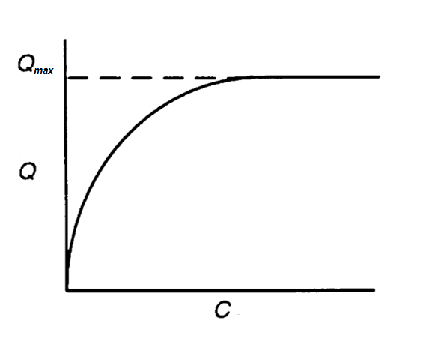
Langmuir Isotherm
Q- Mass of adsorbate / mass of adsorbent
Qmax- Maximum Q to form a mono-layer
c- equilibrium con. of adsorbate in solution
K - constant

Slide 20
Applications of adsorption
(i) Production of high vacuum: The remaining traces of air can be adsorbed by charcoal from a vessel evacuated by a vacuum pump to give a very high vacuum.
(ii) Gas masks: Gas mask (a device which consists of activated charcoal or mixture of adsorbents) is usually used for breathing in coal mines to adsorb poisonous gases.
(iii) Control of humidity: Silica and aluminium gels are used as adsorbents for removing moisture and controlling humidity.

Slide 21
(iv) Removal of colouring matter from solutions: Animal charcoal removes colours of solutions by adsorbing coloured impurities.
(v) Heterogeneous catalysis: Adsorption of reactants on the solid surface of the catalysts increases the rate of reaction. There are many gaseous reactions of industrial importance involving solid catalysts.
(vi) Separation of inert gases: Due to the difference in degree of adsorption of gases by charcoal, a mixture of noble gases can be separated by adsorption on coconut charcoal at different temperatures.
(vii) In curing diseases: A number of drugs are used to kill germs by getting adsorbed on them.
(viii) Froth floatation process: A low grade sulphide ore is concentrated by separating it from silica and other earthy matter by this method using pine oil and frothing agent .
(ix) Adsorption indicators: Surfaces of certain precipitates such as silver halides have the property of adsorbing some dyes like eosin, fluorescein, etc. and thereby producing a characteristic colour at the end point.

Slide 22
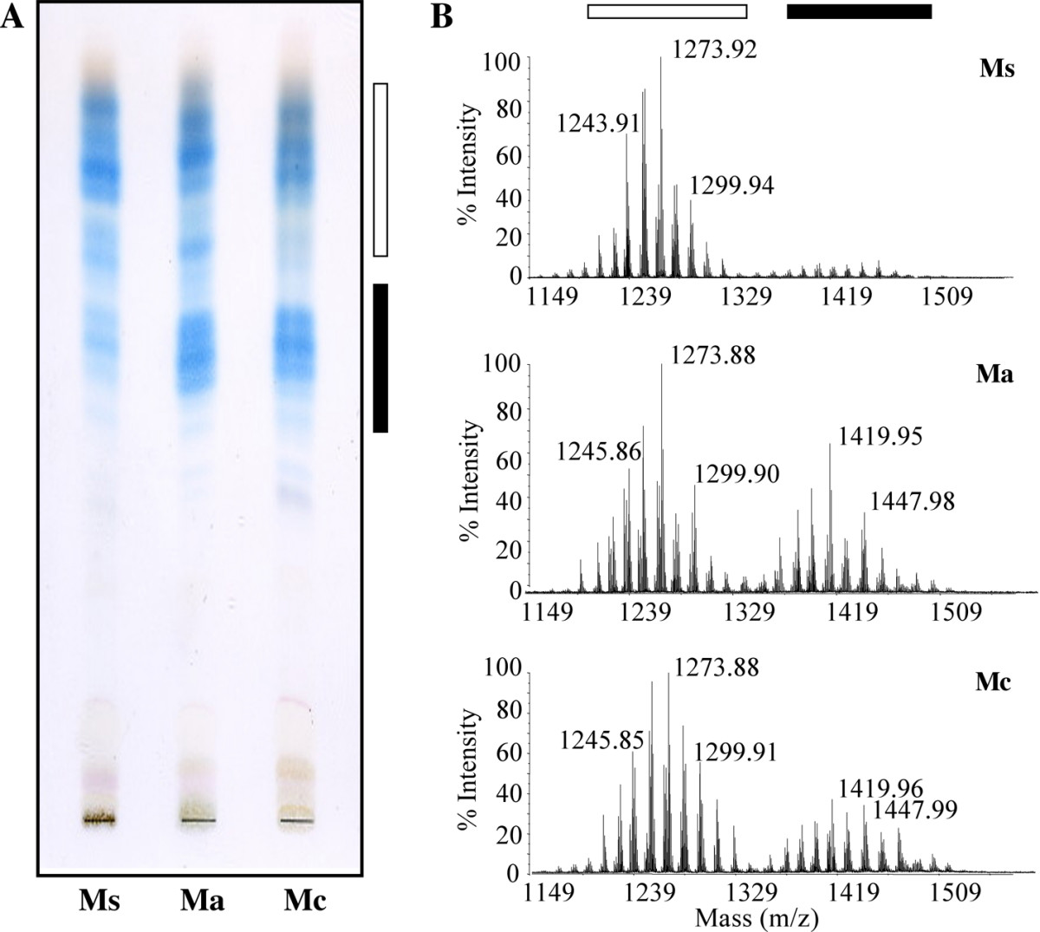
(x) Chromatographic analysis: Chromatographic analysis based on the phenomenon of adsorption finds a number of applications in analytical and industrial fields.

Slide 23
catalysis
(i) Diffusion of reactants to the surface of the catalyst.
(ii) Adsorption of reactant molecules on the surface of the catalyst.
(iii) Occurrence of chemical reaction on the catalyst’s surface through formation of an intermediate
iv)Desorption of reaction products from the catalyst surface ,and thereby, making the surface available again for more reaction to occur.
v) Diffusion of reaction products away from the catalyst’s surface. The surface of the catalyst unlike the inner part of the bulk, has free valencies which provide the seat for chemical forces of attraction. When a gas comes in contact with such a surface, its molecules are held up there due to loose chemical combination. If different molecules are adsorbed side by side, they may react with each other resulting in the formation of new molecules. Thus, formed molecules may evaporate leaving the surface for the fresh reactant molecules.

Slide 24
Colloids
A colloid is a heterogeneous system in which one substance is dispersed (dispersed phase) as very fine particles in another substance called dispersion medium.
In a colloid, the dispersed phase may consist of particles of a single macromolecule (such as protein or synthetic polymer) or an aggregate of many atoms, ions or molecules. Colloidal particles are larger than simple molecules but small enough to remain suspended.

Slide 25
Classification of colloids
Colloids are classified on the basis of the following criteria: (i) Physical state of dispersed phase and dispersion medium
(ii) Nature of interaction between dispersed phase and dispersion medium
(iii) Type of particles of the dispersed phase.

Slide 26
Classification Based on Nature of Interaction between Dispersed Phase and Dispersion Medium
Lyophilic colloids
The word ‘lyophilic’ means liquid-loving. Colloidal sols directly formed by mixing substances like gum, with a suitable liquid (the dispersion medium) are called lyophilic sols.
An important characteristic of these sols is that if the dispersion medium is separated from the dispersed phase (say by evaporation), the sol can be reconstituted by simply remixing with the dispersion medium. That is why these sols are also called reversible sols.

Slide 27
Lyophobic colloids
The word ‘lyophobic’ means liquid-hating. Substances like metals, their sulphides, etc., when simply mixed with the dispersion medium do not form the colloidal sol.
Their colloidal sols can be prepared only by special methods (as discussed later). Such sols are called lyophobic sols. These sols are readily precipitated (or coagulated) on the addition of small amounts of electrolytes, by heating or by shaking and hence, are not stable.
Further, once precipitated, they do not give back the colloidal sol by simple addition of the dispersion medium. Hence, these sols are also called irreversible sols.

Slide 28
Classification of colloids-multimolecular, macromolecular and associative colloids
(i) Multimolecular colloids:
On dissolution, a large number of atoms or smaller molecules of a substance aggregate together to form species having size in the colloidal range (1–1000 nm). The species thus formed are called multimolecular colloids. For example, a gold sol may contain particles of various sizes having many atoms. Sulphur sol consists of particles containing a thousand or more of S₈ sulphur molecules.

Slide 29
(ii) Macromolecular colloids:
Macromolecules in suitable solvents form solutions in which the size of the macromolecules may be in the colloidal range.
Such systems are called macromolecular colloids. These colloids are quite stable and resemble true solutions in many respects.
Examples of naturally occurring macromolecules are starch, cellulose, proteins and enzymes; and those of man-made macromolecules are polythene, nylon, polystyrene, synthetic rubber, etc.

Slide 30
(iii) Associated colloids (Micelles):
There are some substances which at low concentrations behave as normal strong electrolytes, but at higher concentrations exhibit colloidal behaviour due to the formation of aggregates. The aggregated particles thus formed are called micelles.
These are also known as associated colloids. The formation of micelles takes place only above a particular temperature called Kraft temperature (T_{k}) and above a particular concentration called critical micelle concentration (CMC).
On dilution, these colloids revert back to individual ions. Surface active agents such as soaps and synthetic detergents belong to this class. For soaps, the CMC is 10^{–4} to 10^{–3} mol L^{–1}. These colloids have both lyophobic and lyophilic parts. Micelles may contain as many as 100 molecules or more.

Slide 31
Mechanism of micelle formation
Let us take the example of soap solutions. Soap is sodium or potassium salt of a higher fatty acid and may be represented as RCOO–Na⁺ (e.g., sodium stearate CH3(CH₂)₁₆COO–Na⁺, which is a major component of many bar soaps).
When dissolved in water, it dissociates into RCOO– and Na⁺ ions. The RCOO– ions, however, consist of two parts — a long hydrocarbon chain R (also called non-polar ‘tail’) which is hydrophobic (water repelling), and a polar group COO– (also called polar-ionic ‘head’), which is hydrophilic(water loving)

Slide 32
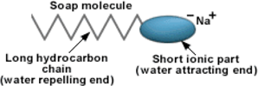

Slide 33
The RCOO– ions are, therefore, present on the surface with their COO– groups in water and the hydrocarbon chains R staying away from it and remain at the surface.
But at critical micelle concentration, the anions are pulled into the bulk of the solution and aggregate to form a spherical shape with their hydrocarbon chains pointing towards the centre of the sphere with COO– part remaining outward on the surface of the sphere. An aggregate thus formed is known as ‘ionic micelle’. These micelles may contain as many as 100 such ions.
Similarly in case of detergents e.g., sodium laurylsulphate, CH3(CH2)11SO4–Na⁺, the polar group is –SO4– along with the long hydrocarbon chain. Hence, the mechanism of micelle formation here also is same as that of soaps.

Slide 34
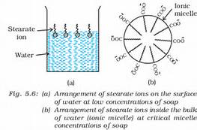

Slide 35
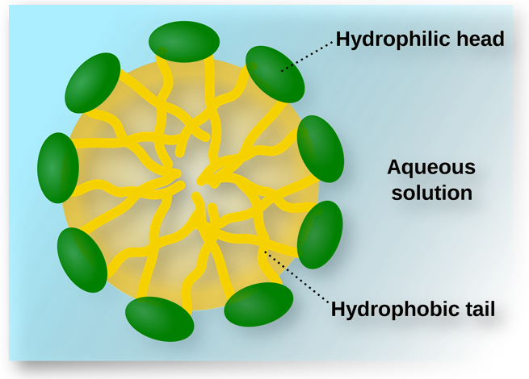
Diagram showing hydrophobic and hydrophilic ends.

Slide 36
Cleansing action of soaps
It has been mentioned earlier that a micelle consists of a hydrophobic hydrocarbon – like central core.
The cleansing action of soap is due to the fact that soap molecules form micelle around the oil droplet in such a way that hydrophobic part of the stearate ions is in the oil droplet and hydrophilic part projects out of the grease droplet like the bristles.
Since the polar groups can interact with water, the oil droplet surrounded by stearate ions is now pulled in water and removed from the dirty surface. Thus soap helps in emulsification and washing away of oils and fats. The negatively charged sheath around the globules prevents them from coming together and forming aggregates.

Slide 37
Preparation of colloids
(a) Chemical methods
Colloidal dispersions can be prepared by chemical reactions leading to formation of molecules by double decomposition, oxidation, reduction or hydrolysis. These molecules then aggregate leading to formation of sols.
FeCl3 + 3H2O ^{hydrolysis}→ Fe(OH)3 (sol) + 3HCl

Slide 38
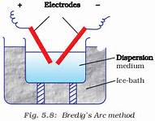
Bredig arc’s method
This process involves dispersion as well as condensation. Colloidal sols of metals such as gold, silver, platinum, etc., can be prepared by this method.
In this method, electric arc is struck between electrodes of the metal immersed in the dispersion medium . The intense heat produced vapourises the metal, which then condenses to form particles of colloidal size.

Slide 39
peptization
Peptization may be defined as the process of converting a precipitate into colloidal sol by shaking it with dispersion medium in the presence of a small amount of electrolyte.
The electrolyte used for this purpose is called peptizing agent. This method is applied, generally, to convert a freshly prepared precipitate into a colloidal sol.
During peptization, the precipitate adsorbs one of the ions of the electrolyte on its surface. This causes the development of positive or negative charge on precipitates, which ultimately break up into smaller particles of the size of a colloid.

Slide 40
Purification of colloidal solutions
Colloidal solutions when prepared, generally contain excessive amount of electrolytes and some other soluble impurities. While the presence of traces of electrolyte is essential for the stability of the colloidal solution, larger quantities coagulate it.
It is, therefore, necessary to reduce the concentration of these soluble impurities to a requisite minimum. The process used for reducing the amount of impurities to a requisite minimum is known as purification of colloidal solution.

Slide 41
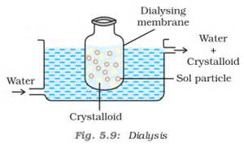
dialysis
It is a process of removing a dissolved substance from a colloidal solution by means of diffusion through a suitable membrane. Since particles (ions or smaller molecules) in a true solution can pass through animal membrane (bladder) or parchment paper or
cellophane sheet but not the colloidal particles, the membrane can be used for dialysis. The apparatus used for this purpose is called dialyser
. A bag of suitable membrane containing the colloidal solution is suspended in a vessel through which fresh water is continuously flowing . The molecules and ions diffuse through membrane into the outer water and pure colloidal solution is left behind.

Slide 42
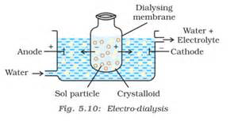
Electro dialysis
Ordinarily, the process of dialysis is quite slow. It can be made faster by applying an electric field if the dissolved substance in the impure colloidal solution is only an electrolyte.
The process is then named electrodialysis. The colloidal solution is placed in a bag of suitable membrane while pure water is taken outside. Electrodes are fitted in the compartment.
The ions present in the colloidal solution migrate out to the oppositely charged electrodes.

Slide 43
ultrafilteration
Ultrafiltration is the process of separating the colloidal particles from the solvent and soluble solutes present in the colloidal solution by specially prepared filters, which are permeable to all substances except the colloidal particles.
Colloidal particles can pass through ordinary filter paper because the pores are too large. However, the pores of filter paper can be reduced in size by impregnating with collodion solution to stop the flow of colloidal particles. The usual collodion is a 4% solution of nitro- cellulose in a mixture of alcohol and ether.
An ultra-filter paper may be prepared by soaking the filter paper in a collodion solution, hardening by formaldehyde and then finally drying it. Thus, by using ultra-filter paper, the colloidal particles are separated from rest of the materials. Ultrafiltration is a slow process.
To speed up the process, pressure or suction is applied. The colloidal particles left on the ultra-filter paper are then stirred with fresh dispersion medium (solvent) to get a pure colloidal solution.

Slide 44
Properties of colloidal solutions
COLLAGATIVE PROPERTIES
Colloidal particles being bigger aggregates, the number of particles in a colloidal solution is comparatively small as compared to a true solution.
Hence, the values of colligative properties (osmotic pressure, lowering in vapour pressure, depression in freezing point and elevation in boiling point) are of small order as compared to values shown by true solutions at same concentrations.

Slide 45
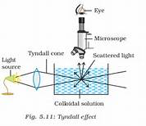
Tyndall effect
Tyndall effect is the scattering of light in a colloidal solutions.
This effect was first observed by Faraday and later studied in detail by Tyndall and is termed as Tyndall effect
The Tyndall effect is due to the fact that colloidal particles scatter light in all directions in space. This scattering of light illuminates the path of beam in the colloidal dispersion.
. Tyndall effect is observed only when the following two conditions are satisfied.
(i) The diameter of the dispersed particles is not much smaller than the wavelength of the light used; and
(ii) The refractive indices of the dispersed phase and the dispersion medium differ greatly in magnitude.

Slide 46
i) Colour: The colour of colloidal solution depends on the wavelength of light scattered by the dispersed particles. The wavelength of light further depends on the size and nature of the particles.
(iv) Brownian movement: When colloidal solutions are viewed under a powerful ultramicroscope, the colloidal particles appear to be in a state of continuous zig-zag motion all over the field of view. This motion was first observed by the British botanist, Robert Brown, and is known as Brownian movement .
This motion is independent of the nature of the colloid but depends on the size of the particles and viscosity of the solution. Smaller the size and lesser the viscosity, faster is the motion.
The Brownian movement has been explained to be due to the unbalanced bombardment of the particles by the molecules of the dispersion medium. The Brownian movement has a stirring effect.

Slide 47
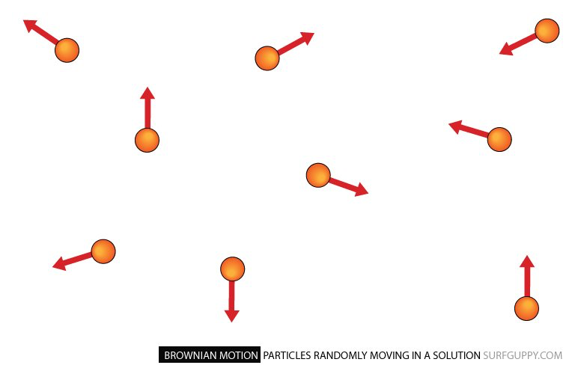
Brownian movement

Slide 48
Charge on colloidal particles:
Colloidal particles always carry an electric charge. The nature of this charge is the same on all the particles in a given colloidal solution and may be either positive or negative.
The charge on the sol particles is due to one or more reasons, viz., due to electron capture by sol particles during electrodispersion of metals, due to preferential adsorption of ions from solution and/or due to formulation of electrical double layer .
Preferential adsorption of ions is the most accepted reason. The sol particles acquire positive or negative charge by preferential adsorption of positive or negative ions. When two or more ions are present in the dispersion medium, preferential adsorption of the ion common to the colloidal particle usually takes place .

Slide 49
The combination of the two layers of opposite charges around the colloidal particle is called Helmholtz electrical double layer. According to modern views, the first layer of ions is firmly held and is termed fixed layer while the second layer is mobile which is termed diffused layer.
Since separation of charge is a seat of potential, the charges of opposite signs on the fixed and diffused parts of the double layer results in a difference in potential between these layers. This potential difference between the fixed layer and the diffused layer of opposite charges is called the electrokinetic potential or zeta potential.

Slide 50
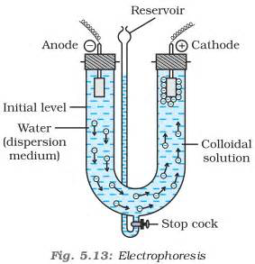
Electrophoresis
When electric potential is applied across two platinum electrodes dipping in a colloidal solution, the colloidal particles move towards one or the other electrode.
The movement of colloidal particles under an applied electric potential is called electrophoresis. Positively charged particles move towards the cathode while negatively charged particles move towards the anode
When electrophoresis that is.,movement of particles is prevented by some suitable means, it is observed that the dispersion medium begins to move in an electric field. This phenomenon is termed electroosmosis.

Slide 51
Coagulation or precipitation
The process of settling of colloidal particles is called coagulation or precipitation of the sol.
Coagulation is carried out by many ways eg:- electrophoresis , mixing two opposite charged sols , by boiling , by persisitent dialysis , by addition of electrolytes.
It has been observed that, generally, the greater the valence of the flocculating ion added, the greater is its power to cause precipitation. This is known as Hardy-Schulze rule. In the coagulation of a negative sol, the flocculating power is in the order: Al³⁺>Ba²⁺>Na⁺

Slide 52
Similarly, in the coagulation of a positive sol, the flocculating power is in the order: [Fe(CN)₆]^{4–} > PO4^{3–} > SO4^{2–} > Cl–
The minimum concentration of an electrolyte in millimoles per litre required to cause precipitation of a sol in two hours is called coagulating value. The smaller the quantity needed, the higher will be the coagulating power of an ion.

Slide 53
Coagulation of lyophilic sols
There are two factors which are responsible for the stability of lyophilic sols. These factors are the charge and solvation of the colloidal particles. When these two factors are removed, a lyophilic sol can be coagulated. This is done
(i) by adding an electrolyte and
(ii) by adding a suitable solvent. When solvents such as alcohol and acetone are added to hydrophilic sols, the dehydration of dispersed phase occurs. Under this condition, a small quantity of electrolyte can bring about coagulation.

Slide 54
Protection of colloids
Lyophilic sols are more stable than lyophobic sols. This is due to the fact that lyophilic colloids are extensively solvated, i.e., colloidal particles are covered by a sheath of the liquid in which they are dispersed.
Lyophilic colloids have a unique property of protecting lyophobic colloids. When a lyophilic sol is added to the lyophobic sol, the lyophilic particles form a layer around lyophobic particles and thus protect the latter from electrolytes. Lyophilic colloids used for this purpose are called protective colloids.

Slide 55
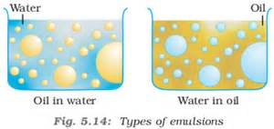
Emulsions
These are liquid-liquid colloidal systems, i.e., the dispersion of finely divided droplets in another liquid. If a mixture of two immiscible or partially miscible liquids is shaken, a coarse dispersion of one liquid in the other is obtained which is called emulsion. Generally, one of the two liquids is water. There are two types of emulsions. (i) Oil dispersed in water (O/W type) and (ii) Water dispersed in oil (W/O type).

Slide 56
mulsions of oil in water are unstable and sometimes they separate into two layers on standing. For stabilisation of an emulsion, a third component called emulsifying agent is usually added.
The emulsifying agent forms an interfacial film between suspended particles and the medium. The principal emulsifying agents for O/W emulsions are proteins, gums, natural and synthetic soaps, etc., and for W/O, heavy metal salts of fatty acids, long chain alcohols, lampblack, etc.
Emulsions can be diluted with any amount of the dispersion medium. On the other hand, the dispersed liquid when mixed, forms a separate layer. The droplets in emulsions are often negatively charged and can be precipitated by electrolytes. They also show Brownian movement and Tyndall effect. Emulsions can be broken into constituent liquids by heating, freezing, centrifuging, etc.

Slide 57
Colloids around us
Examples are :-
Blue colour of sky
Fog mist and rain.
Food particles
Blood
Soil
Formation of a delta.

Slide 58
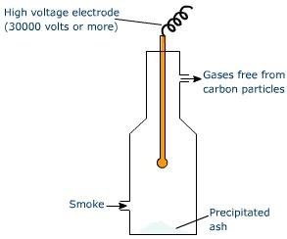
Applications of colloids
(i) Electrical precipitation of smoke: Smoke is a colloidal solution of solid particles such as carbon, arsenic compounds, dust, etc., in air.
The smoke, before it comes out from the chimney, is led through a chamber containing plates having a charge opposite to that carried by smoke particles.
The particles on coming in contact with these plates lose their charge and get precipitated. The particles thus settle down on the floor of the chamber. The precipitator is called Cottrell precipitator

Slide 59
(ii) Purification of drinking water: The water obtained from natural sources often contains suspended impurities. Alum is added to such water to coagulate the suspended impurities and make water fit for drinking purposes.
(iii) Medicines: Most of the medicines are colloidal in nature. For example, argyrol is a silver sol used as an eye lotion. Colloidal antimony is used in curing kalaazar. Colloidal gold is used for intramuscular injection. Milk of magnesia, an emulsion, is used for stomach disorders. Colloidal medicines are more effective because they have large surface area and are therefore easily assimilated.
Tanning: Animal hides are colloidal in nature. When a hide, which has positively charged particles, is soaked in tannin, which contains negatively charged colloidal particles, mutual coagulation takes place. This results in the hardening of leather. This process is termed as tanning. Chromium salts are also used in place of tannin.

Slide 60
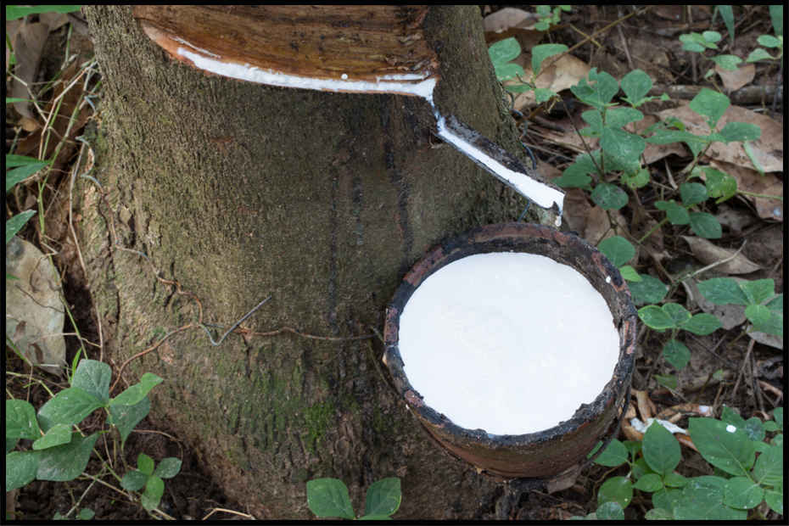
(vi) Photographic plates and films: Photographic plates or films are prepared by coating an emulsion of the light sensitive silver bromide in gelatin over glass plates or celluloid films.
(vii) Rubber industry: Latex is a colloidal solution of rubber particles which are negatively charged. Rubber is obtained by coagulation of latex.
(viii) Industrial products: Paints, inks, synthetic plastics, rubber, graphite lubricants, cement, etc., are all colloidal solutions
THE END

