Slide 1
TEM and SEM

Slide 3
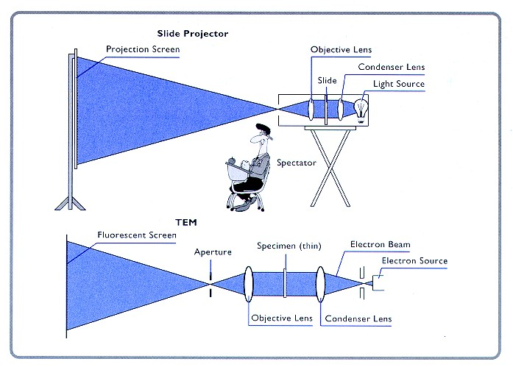
A transmission Electron Microscope is anologous to a slide projector as indicated by
Philips below
Transmission electron microscopy (TEM) is a microscopy technique in which a beam of electrons is transmitted through an ultra-thin specimen, interacting with the specimen as it passes through it. An image is formed from the interaction of the electrons transmitted through the specimen; the image is magnified and focused onto an imaging device, such as a fluorescent screen, on a layer of photographic film, or to be detected by a sensor such as a charge-coupled device

Slide 4
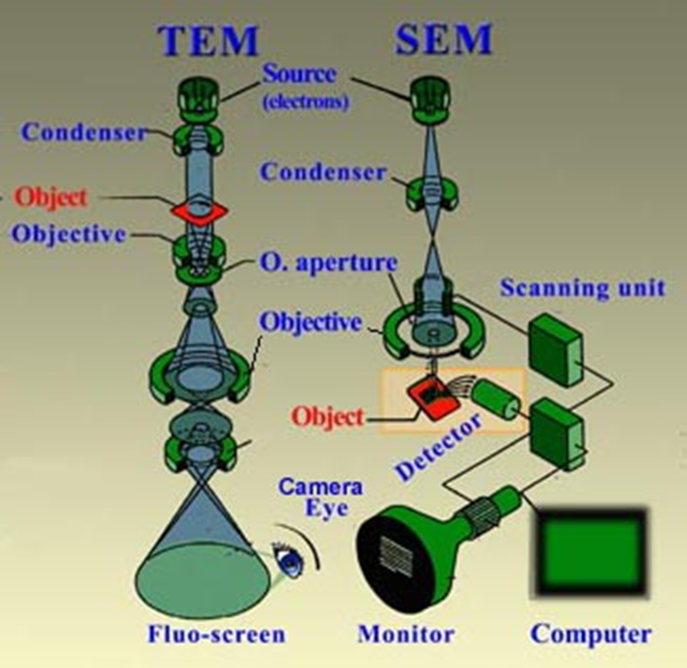
In a conventional transmission electron microscope, a thin specimen is irradiated with an electron beam of uniform current density. Electrons are emitted from the electron gun and illuminate the specimen through a two or three stage condenser lens system. Objective lens provides the formation of either image or diffraction pattern of the specimen.
The electron intensity distribution behind the specimen is magnified with a three or four stage lens system and viewed on a fluorescent screen. The image can be recorded by direct exposure of a photographic emulsion or an image plate or digitally by a CCD camera.
The acceleration voltage of up to date routine instruments is 120 to 200 kV. Medium-voltage instruments work at 200-500 kV to provide a better transmission and resolution, and in high voltage electron microscopy (HVEM) the acceleration voltage is in the range 500 kV to 3 MV. Acceleration voltage determines the velocity, wavelength and hence the resolution (ability to distinguish the neighbouring microstructural features) of the microscope.

Slide 5
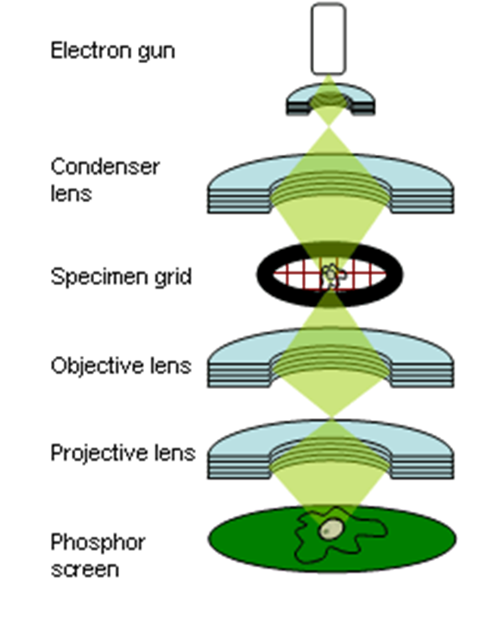
The "Virtual Source" at the top represents the electron gun, producing a stream of monochromatic electrons.
This stream is focused to a small, thin, coherent beam by the use of condenser lenses 1 and 2. The first lens (usually controlled by the "spot size knob") largely determines the "spot size"; the general size range of the final spot that strikes the sample.
The second lens (usually controlled by the "intensity or brightness knob" actually changes the size of the spot on the sample; changing it from a wide dispersed spot to a pinpoint beam.
The beam is restricted by the condenser aperture (usually user selectable), knocking out high angle electrons (those far from the optic axis, the dotted line down the center)
The beam strikes the specimen and parts of it are transmitted
This transmitted portion is focused by the objective lens into an image
The image is passed down the column through the projector lenses, being enlarged all the way.
The image strikes the phosphor image screen and light is generated, allowing the user to see the image

Slide 6
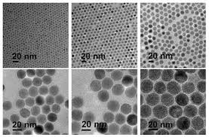
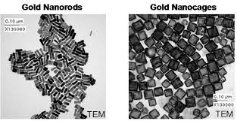
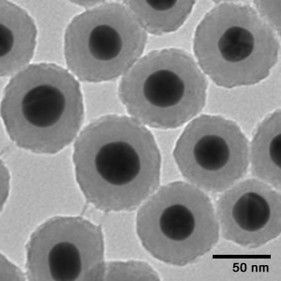
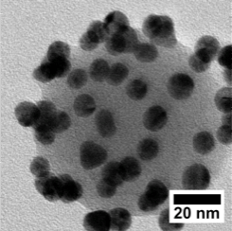
Topography
The surface features of an object or "how it looks", its texture; direct relation between these features and materials properties (hardness, reflectivity...etc.)
Morphology
The shape and size of the particles making up the object; direct relation between these structures and materials properties (ductility, strength, reactivity...etc.)
Composition
The elements and compounds that the object is composed of and the relative amounts of them; direct relationship between composition and materials properties (melting point, reactivity, hardness...etc.)
Crystallographic Information. How the atoms are arranged in the object; direct relation between these arrangements and materials properties (conductivity, electrical properties, strength...etc.)

Slide 7
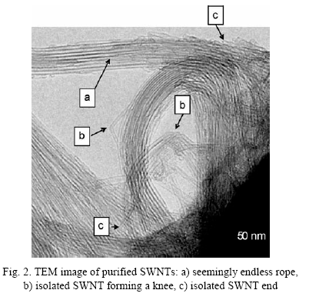
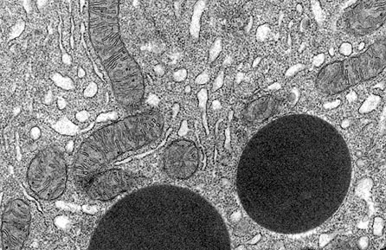
mitochondria

Slide 8
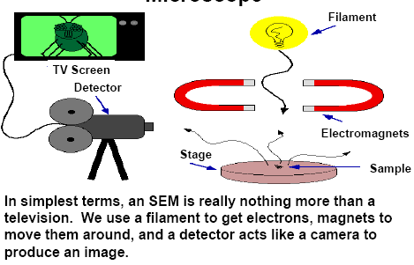

Slide 9
Scanning Electron Microscopy (SEM)
Scanning electron microscopy is used for inspecting topographies of specimens at very high magnifications using a piece of equipment called the scanning electron microscope.
SEM inspection is often used in the analysis of package cracks and fracture surfaces, bond failures, and physical defects on the die or package surface.
During SEM inspection, a beam of electrons is focused on a spot volume of the specimen, resulting in the transfer of energy to the spot. These bombarding electrons, also referred to as primary electrons, dislodge electrons from the specimen itself. The dislodged electrons, also known as secondary electrons, are attracted and collected by a positively biased grid or detector, and then translated into a signal.
To produce the SEM image, the electron beam is swept across the area being inspected, producing many such signals. These signals are then amplified, analyzed, and translated into images of the topography being inspected. Finally, the image is shown on a CRT.

Slide 10
Scanning Electron Microscopy (SEM)
The energy of the primary electrons determines the quantity of secondary electrons collected during inspection. The emission of secondary electrons from the specimen increases as the energy of the primary electron beam increases, until a certain limit is reached. Beyond this limit, the collected secondary electrons diminish as the energy of the primary beam is increased, because the primary beam is already activating electrons deep below the surface of the specimen. Electrons coming from such depths usually recombine before reaching the surface for emission.
Aside from secondary electrons, the primary electron beam results in the emission of backscattered (or reflected) electrons from the specimen. Backscattered electrons possess more energy than secondary electrons, and have a definite direction. As such, they can not be collected by a secondary electron detector, unless the detector is directly in their path of travel. All emissions above 50 eV are considered to be backscattered electrons.

Slide 11
Scanning Electron Microscopy (SEM)
Backscattered electron imaging is useful in distinguishing one material from another, since the yield of the collected backscattered electrons increases monotonically with the specimen's atomic number. Backscatter imaging can distinguish elements with atomic number differences of at least 3, i.e., materials with atomic number differences of at least 3 would appear with good contrast on the image. For example, inspecting the remaining Au on an Al bond pad after its Au ball bond has lifted off would be easier using backscatter imaging, since the Au islets would stand out from the Al background.
A SEM may be equipped with an EDX analysis system to enable it to perform compositional analysis on specimens. EDX analysis is useful in identifying materials and contaminants, as well as estimating their relative concentrations on the surface of the specimen.

Slide 13
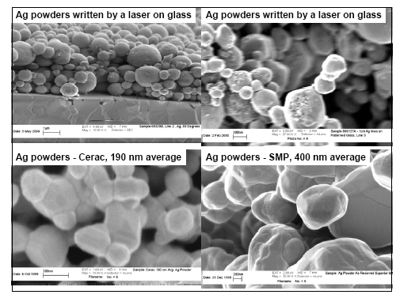

Slide 14
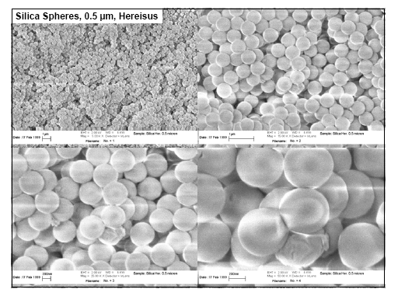

Slide 15
